Slide 1
Mentoring
Instructional Coaching
September 22, 2014
Notes:
Introductions (Lead Mentors)
Mentors- Name, Position, School ( Jim)
Collaborative Norms ( Anna)
1) Popcorn how you felt as a first year teacher. 1st month of school.
2) Turn to an elbow partner use one or two words to describe characteristics of a colleague who helped you as a first year teacher.

Slide 2
Learning Target
I can identify the roles of a Instructional Mentor.
I can effectively use a CAL to guide my mentee.
I am comfortable using mentoring language stems.
I understand my role in a triad conversation.
Notes:
Steve

Slide 3
Review and New
The keys to a strong Mentor/Mentee relationship
Trust
Benefits of a strong mentoring program
Retention of teachers
Better teachers faster
Notes:
15 minutes Casper
Pose questions: How do we develop good professional relationships? Break into groups of three list 5 things needed for a good relationship. Discuss why important.

Slide 4
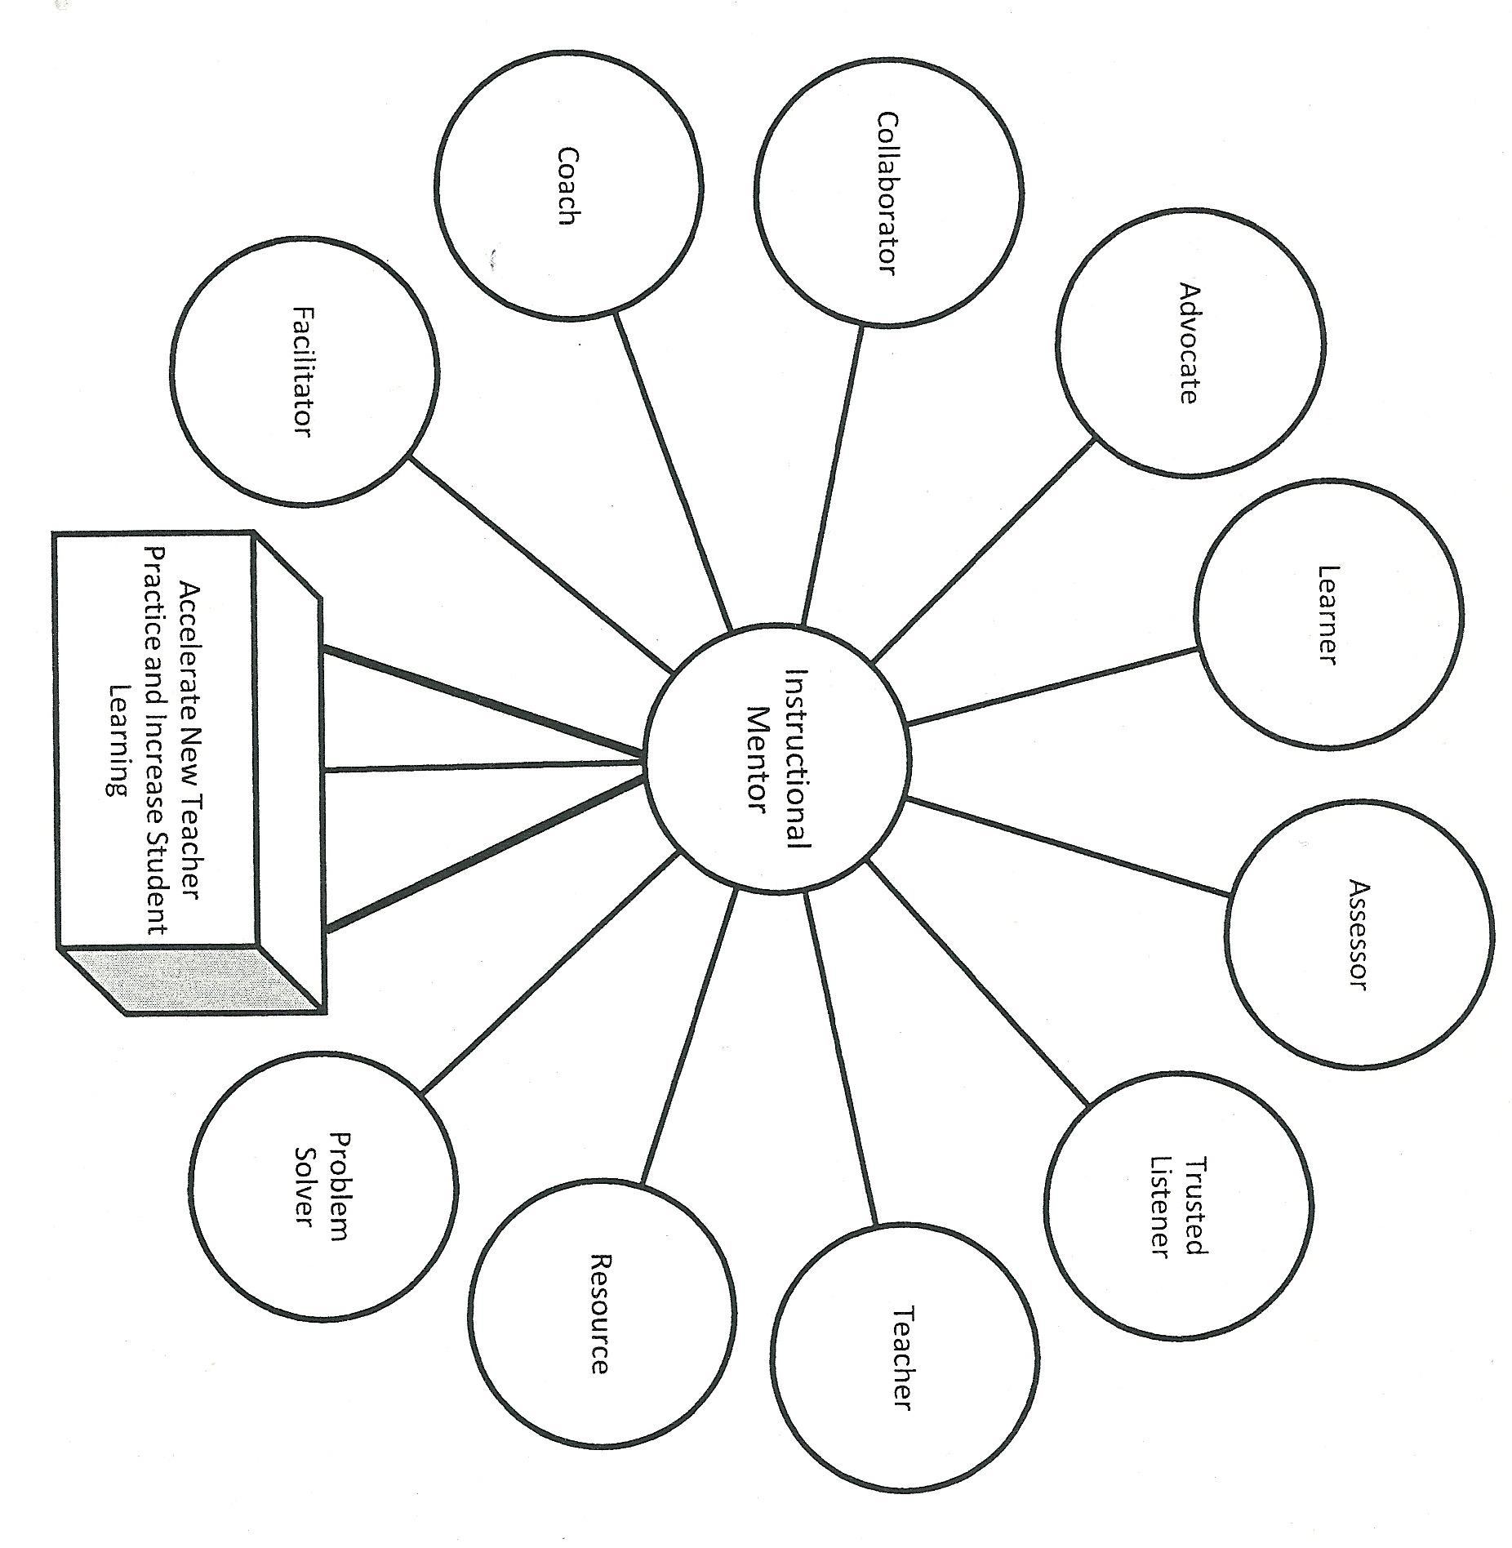
Instructional Mentoring Roles
Notes:
Anna
- Two circles that you connect well with
- Two circles that you feel you could benefit for more training one

Slide 5
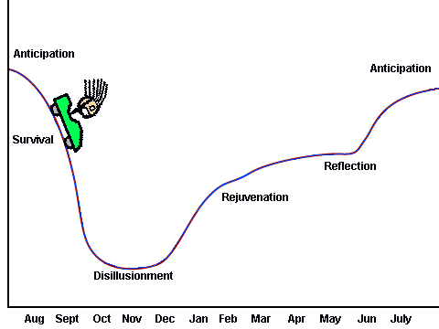
The Roller Coaster
http://blogs.edweek.org/teachers/coach_gs_teaching_tips/First-Year%20Teaching.gif
Notes:
2 minutes
Steve
Link this back to earlier conversation about initial teachers and feelings at the beginning to the school year. Phases and what is going on during these times (parent teacher conferences, winter break, Spring break). Not to be shared with new teachers. Additionally, we all feel this way not just initial teachers.

Slide 6
Guidelines for Responding
Be empathetic
Make connections:
between ideas expressed
to your own experiences
Summarize or paraphrase key ideas/feeling
Extend and deepen thinking by:
Posing questions (Not WHY)
Making suggestions (when asked)
Sharing resources or knowledge (limited and strategic)
Maintain nonjudgmental language
Notes:
Steve
10 Minutes
Read slide, give examples, elbow partner Where else in your life might you be able to use these guidelines?
Make the parallel between you and your wife

Slide 7
Mentoring Conversations
Types of Conversations:
Collaborative - Communication shared
Facilitative - Communication lead by Mentee
Instructional - Communication lead by Mentor
Notes:
Steve
5 minutes
Example: Buddy mentoring
Where do I go for the fire drill?
Flowchart and triangle (communication supporting new teachers)

Slide 8
Active Listening
Using the language of active listening
Paraphrasing
Clarifying
Mediational Questions
Non-Judgmental Responses
Suggestions
Teachable Moments
Suggestion Stems
Notes:
All of Us
5 minutes
- Hand out Stems
- Talk about Stems and their uses
- Think about a recent conversation you had with your mentee and what language stems you might have used. How do these stems lead to conversations as part of your role as an instructional mentor
Break after this slide (10-15 minutes depending on time frame)
Introduce Stems and talk about them (categories). Where else might you use these stems.

Slide 9
Attitudes for Effective Listening
You must truly want to hear what the other person has to say
You must view the other person as a separate person from yourself
You must genuinely be able to accept the other person's feeling, no matter how different from your own feeling.
You must trust the other person's capacity to handle, work through, and find solutions to his/her problems.
Notes:
Casper
2-3 minutes
Refer back to cartoon

Slide 10
Elbow Partner Activity
Using the "The New Teacher Says..." page in your packet:
Use active listening stems to respond to your partner
using at least one stem from each group
Notes:
Casper
5 minute explanation
10 minutes work on activity
5 minutes to share out

Slide 11
Collaborative Assessment Log
What is a C.A.L.?
A tool to guide conversations and tasks
Guidance for mentor's support
A record of the mentor/mentee meeting
Accountability piece for mentee
Notes:
Steve/Casper/Adl
25 minutes for entire activity
1-2 minute explain slide
5 minutes to look at CAL on ELMO
What do you see? How might you use it?
Video of using Cal
While watching the video please make note of any mentoring language stems you see
Discussion of notes

Slide 12
Practice Using C.A.L.
Use a C.A.L. to guide your reflection on the following prompt:
“Classroom Management"
What is working
Goals, Challenges, Concerns
Teacher's Next Step
District's Next Step
Notes:
Casper/ Steve/ Anna
Model using CAL Mentor- Anna New Teacher- Jim
Now you fill out a CAL
5 minutes
http://www.online-stopwatch.com/
Practice using the Cal individually so when you work with your next quadrant you are less focused on documentation and more focused on using language stems to facilitate your conversation
Casper will show his CAL, Steve and Jim will model activity after CAL .

Slide 13
Activity
Using the CAL you just completed, have a conversation with a partner using the active listening stems.
Notes:
Casper will show his CAL, Steve and Jim will model activity after CAL .
Explain directions give the person your CAL to practice mentoring language
5 minutes per person
http://www.online-stopwatch.com/
Now fill out a CAL with this partner using the topic Instructional Mentoring. Use the CAL and your language stems.
5 minutes per person

Slide 14
Triad Conversations
Three-Way Conversation:
This will take place after one of the principal observations. The role of the mentor is as a silent observer. A conversation will take place between the mentor and mentee after this meeting to discuss the post-observation meeting.
Notes:
Anna
Reivew Triad Graphic and Lines of communication
Practice Triad Conversation using CAL/ Scenarios

Slide 15
The Future!
Lead Mentors > <Mentor> <Mentee
Building a Mentor Coach
Mentor Certification
Two Year Timeline
Ongoing support and training
Notes:
Casper
PI- 34/ PDP/SLO/Educator Effectiveness

Slide 16
Cardinal Stritch Training Dates
Instructional Mentoring ( Prerequisite for most other classes)
October 22 & 23, 2014
Observing & Conferencing
November 11 & 12, 2014
January 14 & 15, 2015
Using Data to Inform Instruction
December 9 & 10, 2014
February 3 & 4, 2015
Designing Effective Instruction
March 3 & 4, 2015
Coaching in Complex Situations
February 19, 2015
Mentoring for Equity
April 22 & 23, 2015
Designing & Presenting Professional Development
May 19 & 20, 2015

Slide 17
Future Mentor Forum Dates
November 3rd 12:30-3:30 p.m.
May 4th 12:30-3:30 p.m.

